Slide 1
CPBP 8306: Statistics & visualization day 2
Stevenson Science & Engineering Library
Joshua Borycz

Slide 2
Generalized linear model

Slide 3
Generalized linear model
A generalized linear model (GLM) is a statistical model that allows you to analyze the relationship between a response variable and one or more explanatory variables. It is a more flexible version of the traditional linear regression model, as it can handle different types of response variables, such as binary, count, or skewed data, not just continuous variables.
gaussian: Assumes the response variable follows a normal (Gaussian) distribution. The default link function is the identity link (same as lm)
binomial: Assumes the response variable is binary (0 or 1, success or failure). The default link function is the logit link.
poisson: Assumes the response variable is a count variable. The default link function is the log link.
gamma: Assumes the response variable is positive and continuous with a skewed distribution. The default link function is the inverse link.
inverse.gaussian: Assumes the response variable is positive and continuous with a distribution similar to the Gaussian distribution but with a long right tail. The default link function is the inverse squared link.
quasi: Allows for flexible modeling of the mean-variance relationship when the distribution is not known.
Notes:
Note: We have only restructured the data and removed non data content (e.g., title and descriptions)
The data still contains the same number of cells, but now facilitates machine analysis
Good practice to only include data in your data file and all other contextual information should be addressed in other locations (e.g., ReadMe, data dictionary)

Slide 4
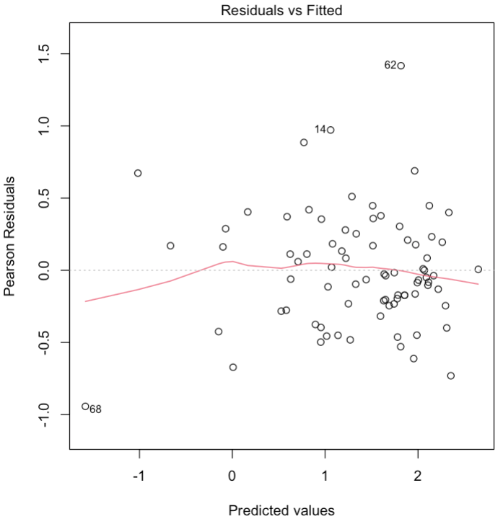
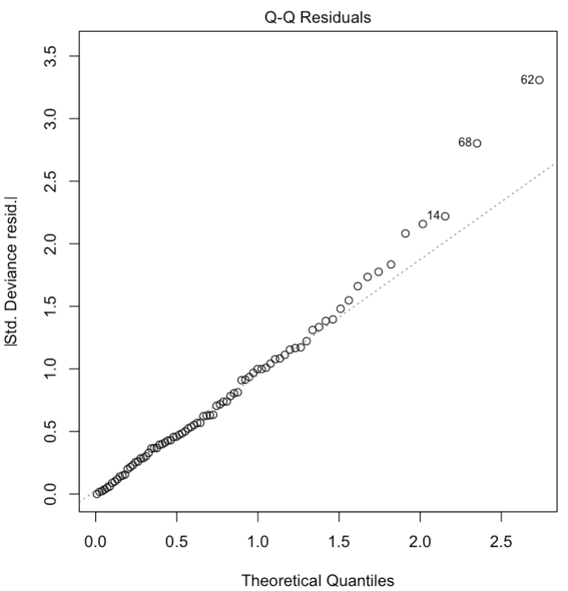
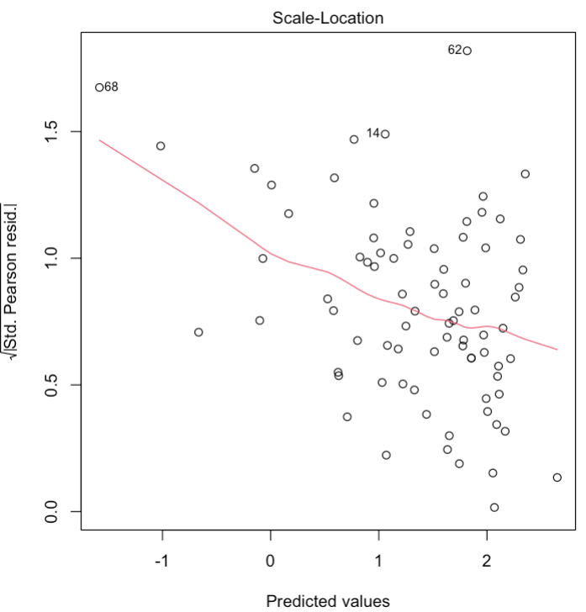
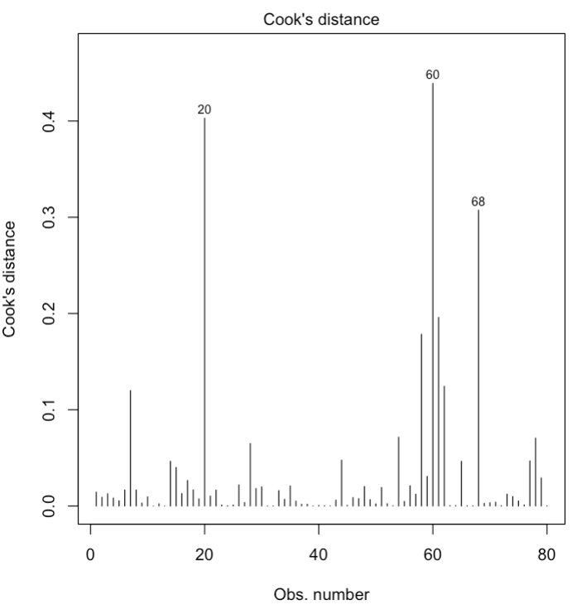
Diagnostic plots
Diagnostic plots look at data residuals, which are differences between the observed values and the predicted values from a statistical model. They are the leftover, unexplained variation in the data after the model has been fitted.
Residuals vs Fitted: Shows the relationship between the residuals and the fitted values (the predicted values) from the model. Identifies non-linearity, unequal variances, or the need for transformations.
QQ (Quantile-Quantile): Compares the distribution of the residuals to a normal distribution. If the residuals are normally distributed, the points on the plot will fall along a straight line. Identifies non-normality.
Scale-Location: Shows the square root of the standardized residuals plotted against the fitted values. Identifies unequal variances.
Cook's Distance: Cook's distance is a measure of the influence of each data point on the model. Points with high Cook's distance values may be influential observations.
Notes:
Note: We have only restructured the data and removed non data content (e.g., title and descriptions)
The data still contains the same number of cells, but now facilitates machine analysis
Good practice to only include data in your data file and all other contextual information should be addressed in other locations (e.g., ReadMe, data dictionary)

Slide 5
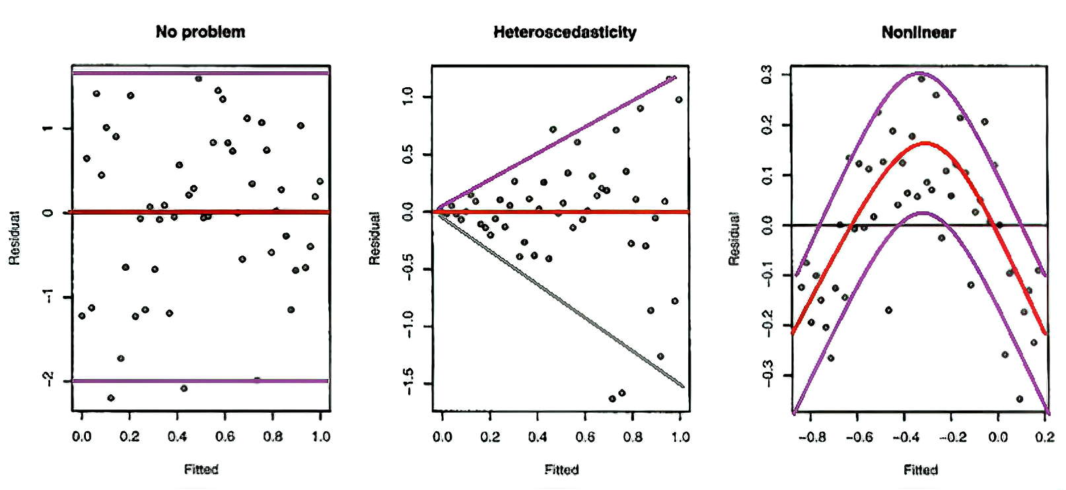
Residuals vs fitted
Residuals vs Fitted: Shows the relationship between the residuals and the fitted values (the predicted values) from the model. Identifies non-linearity, unequal variances, or the need for transformations.
Notes:
Note: We have only restructured the data and removed non data content (e.g., title and descriptions)
The data still contains the same number of cells, but now facilitates machine analysis
Good practice to only include data in your data file and all other contextual information should be addressed in other locations (e.g., ReadMe, data dictionary)

Slide 6
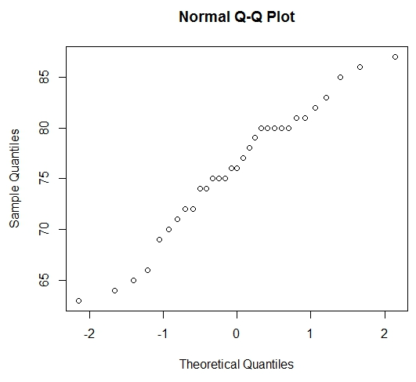
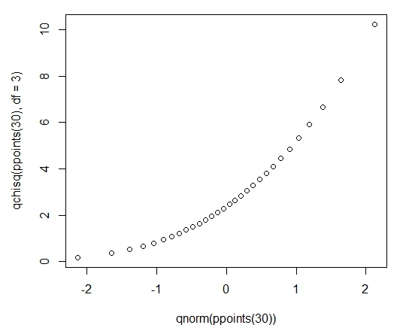
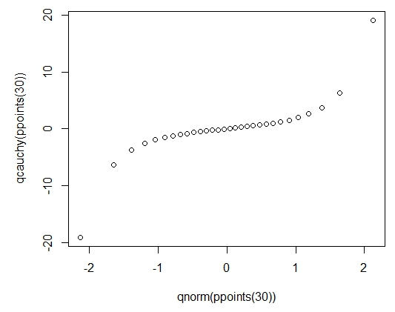
QQ plot
QQ (Quantile-Quantile): Compares the distribution of the residuals to a normal distribution. If the residuals are normally distributed, the points on the plot will fall along a straight line. Identifies non-normality.
Skewed data
Extreme values
Notes:
Note: We have only restructured the data and removed non data content (e.g., title and descriptions)
The data still contains the same number of cells, but now facilitates machine analysis
Good practice to only include data in your data file and all other contextual information should be addressed in other locations (e.g., ReadMe, data dictionary)

Slide 7
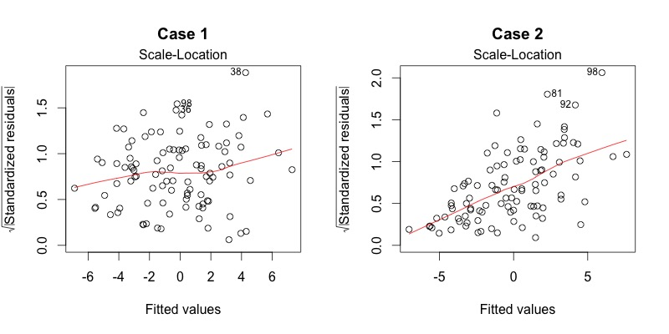
Scale location
Scale-Location: Shows the square root of the standardized residuals plotted against the fitted values. Identifies unequal variances.
homoscedastic
heteroscedastic
Notes:
Note: We have only restructured the data and removed non data content (e.g., title and descriptions)
The data still contains the same number of cells, but now facilitates machine analysis
Good practice to only include data in your data file and all other contextual information should be addressed in other locations (e.g., ReadMe, data dictionary)

Slide 8
Cook’s distance
Cook's Distance: Cook's distance is a measure of the influence of each data point on the model. Points with high Cook's distance values may be influential observations.
> 1.0 correspond to clearly influential points,
> 0.5 have some influence and
< 0.5 indicate points that are not influential
Notes:
Note: We have only restructured the data and removed non data content (e.g., title and descriptions)
The data still contains the same number of cells, but now facilitates machine analysis
Good practice to only include data in your data file and all other contextual information should be addressed in other locations (e.g., ReadMe, data dictionary)

Slide 9
Principle component analysis

Slide 10
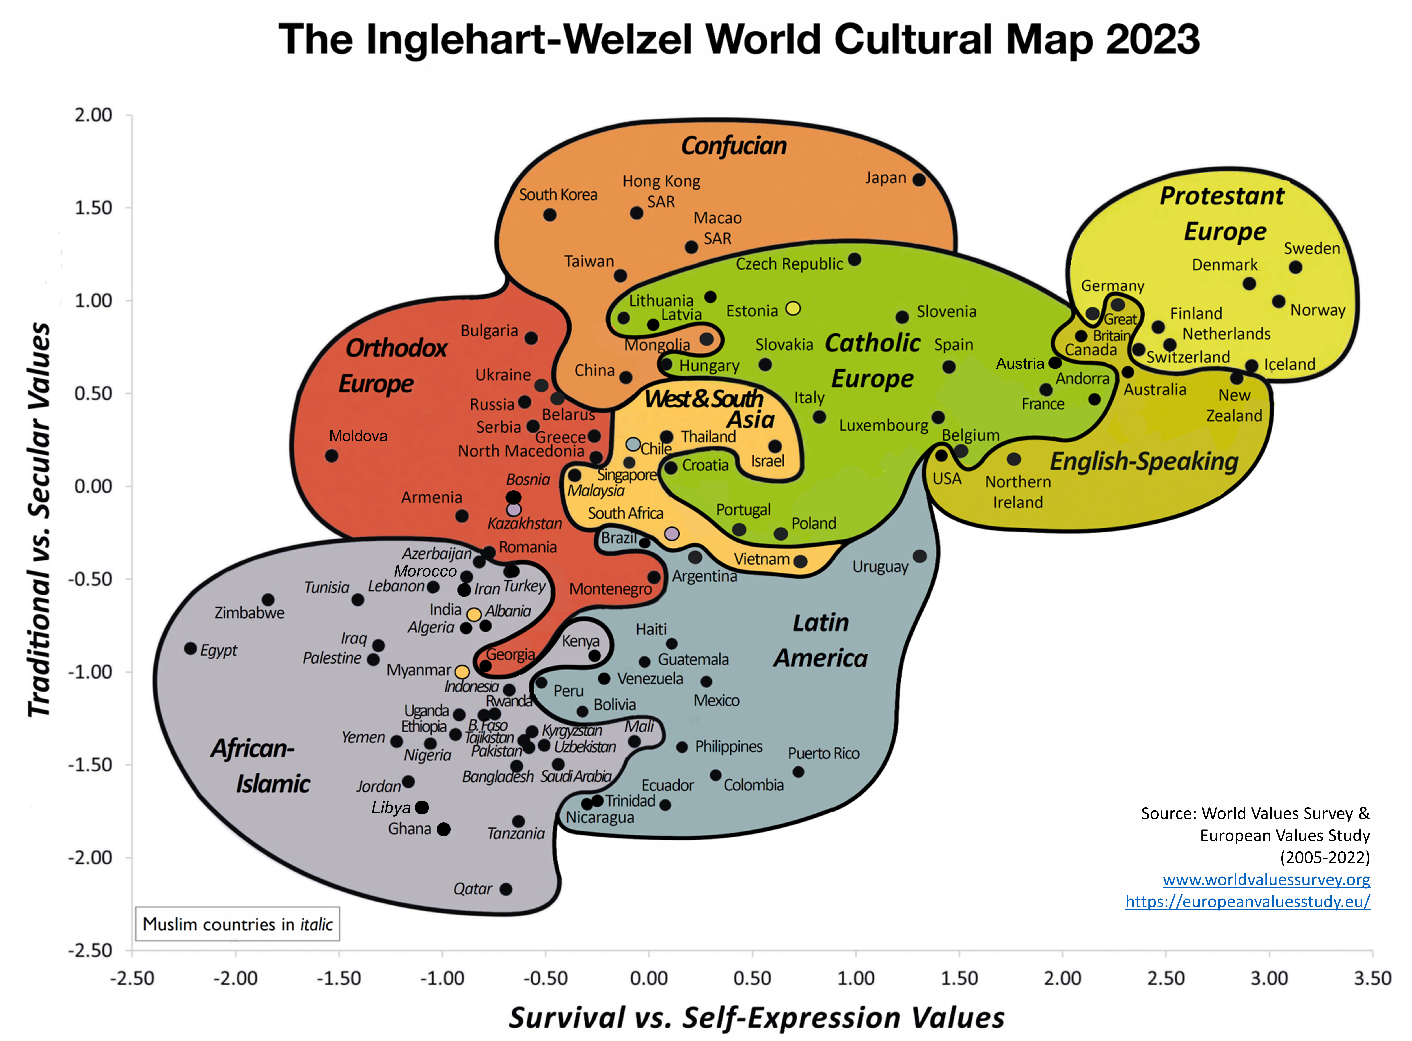
Principle component analysis
Multivariate Methods: Statistical techniques used to analyze data with multiple variables or measurements.
Dimension Reduction: Simplify complex datasets by reducing the number of variables or features
Multiple Factor Analysis (MFA): Dimension reduction methods that can handle numerical, categorical, or ordinal variables
Principal Component Analysis (PCA): Dimension reduction method that applies to numerical variables, assumes linear relationships, and gaussian distributions. New dimension are called principal components
https://www.worldvaluessurvey.org/WVSContents.jsp?CMSID=Findings

Slide 11
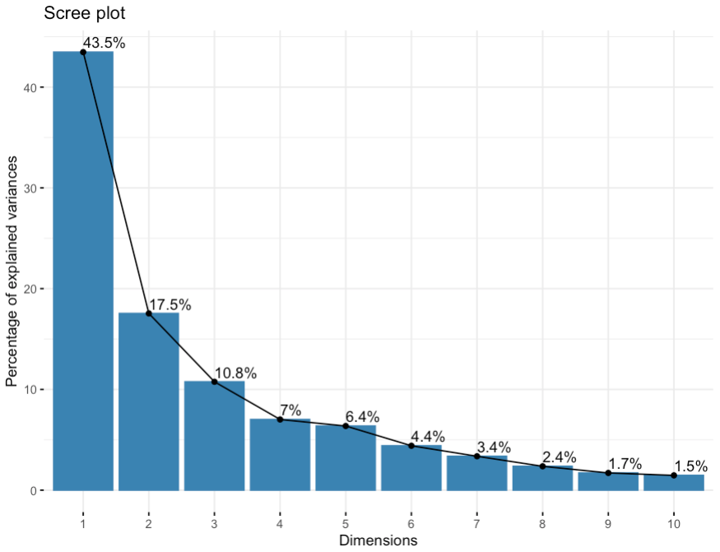
Principle component analysis
Eigenvalues: How much of the overall variation in the data is explained by each principal component
Coordinates: How each individual data point is positioned on the principal components
Cosine squared (cos2): How well each variable is represented by the principal components. It ranges from 0 to 1, with 1 meaning meaning well represented
Contributions: How much each variable contributes to the formation of each principal component
Rotation: Changes the dimensions in multidimensional space to ease interpretation
Varimax and quartimax are orthogonal methods that simplify columns and rows, respectively.
Oblimin (oblique rotation) is non-orthogonal and simplifies rows and columns

Slide 12
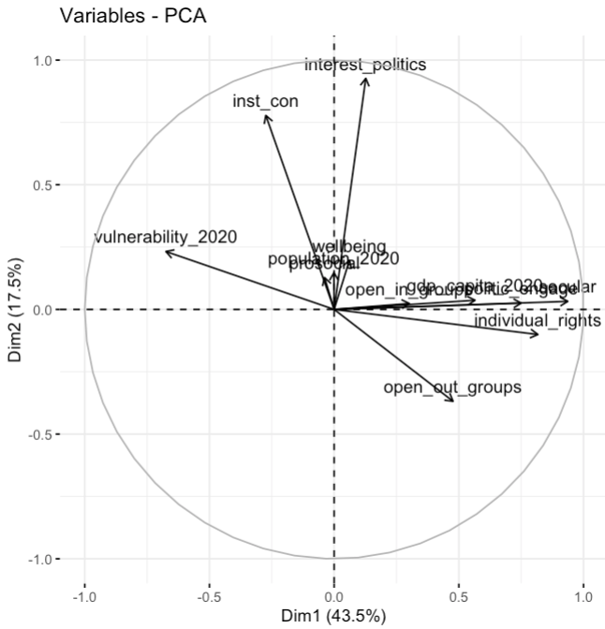
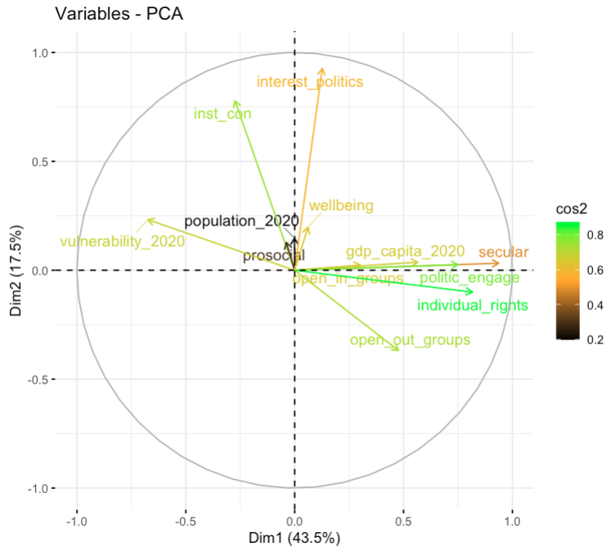
Principle component analysis
Biplots

Slide 13
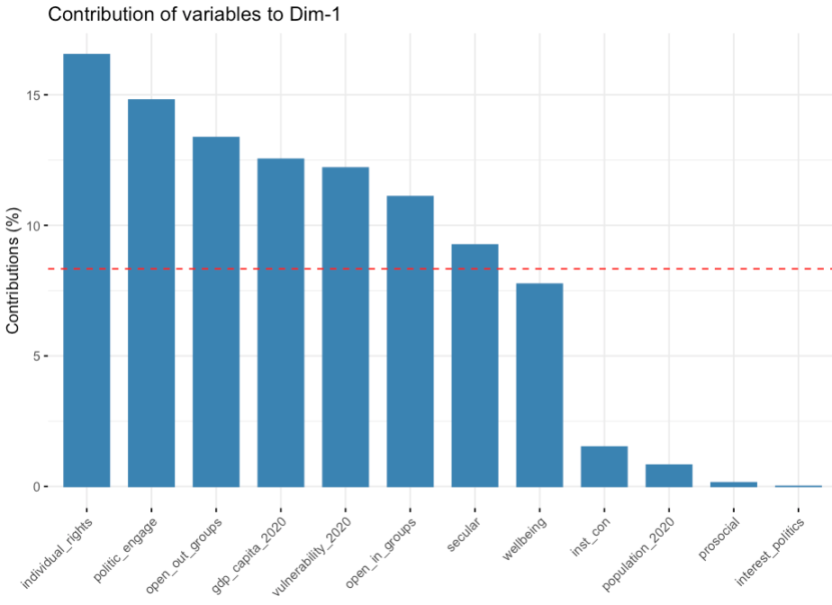
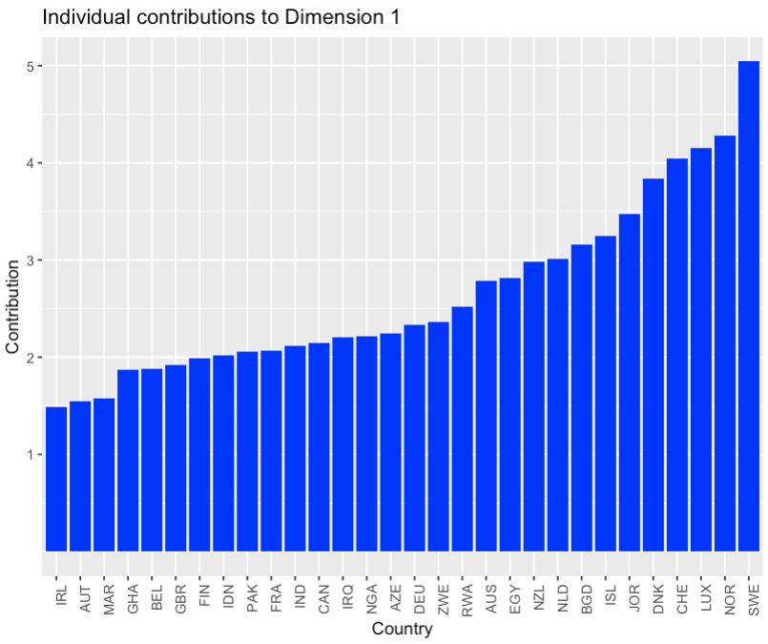
Principle component analysis
Contribution plots

Slide 14
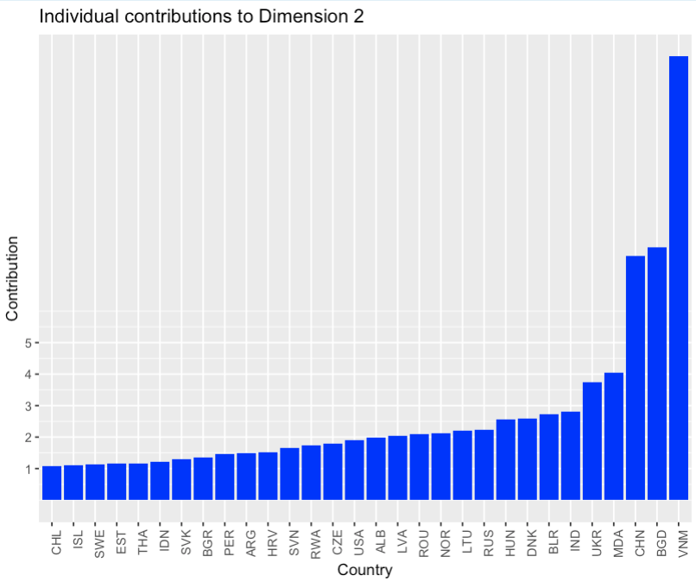
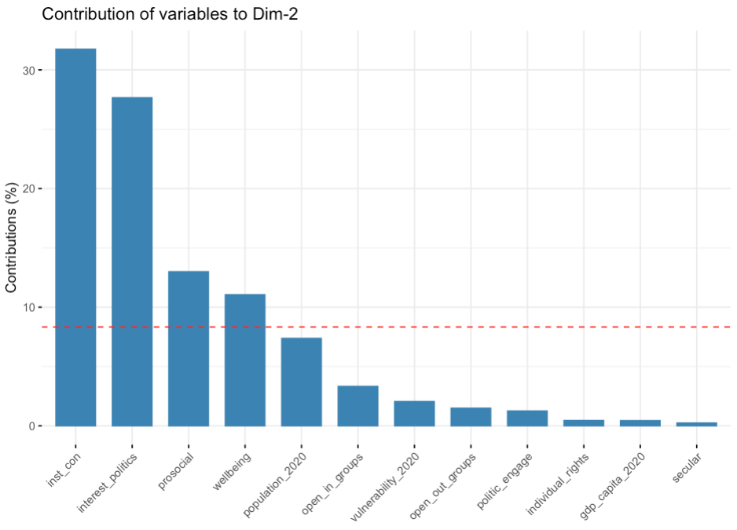
Principle component analysis
Contribution plots

